Slide 1
TrueStable Finance
Leverage your token by stableCoin
TrueStable Team

Slide 2

Introduction
Market Situations
Users
Long one token, no selling
Protocols
Enhance ecosystem
Investors
Max profit for one token

Slide 3
TrueStable Solution
One example: ORE
ORE: 8% APR for staking
1. Users: stake token(ORE) , get more stableCoin(USDC)
2. Investors: max profit for one token(ORE)
3. Protocol(ORE): supply stable option for ecosystem

Slide 4
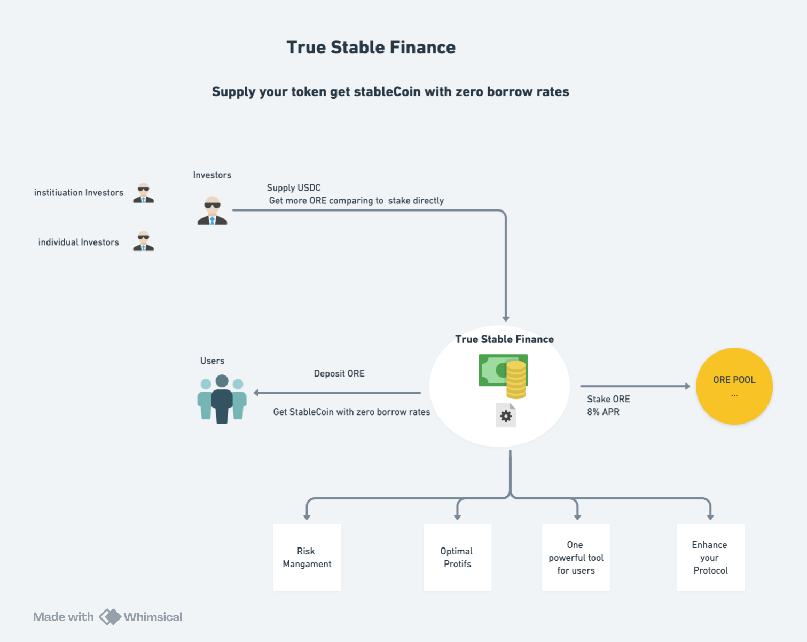
Mechanism

Slide 5
Materials
WebSite
Github

